Slide 1


Pizza Sales Analysis Interactive Dashboard Report

Slide 2
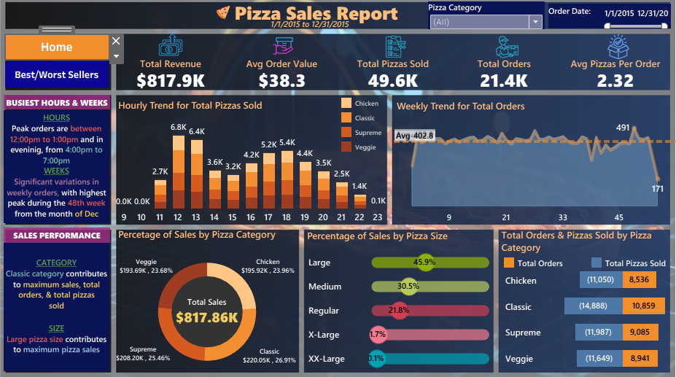

Slide 3
Dashboard Link:
https://public.tableau.com/views/pizzasales1/Home?:language=en-GB&:sid=&:redirect=auth&:display_count=n&:origin=viz_share_link

